Slide 1

Computer System Servicing

Slide 2
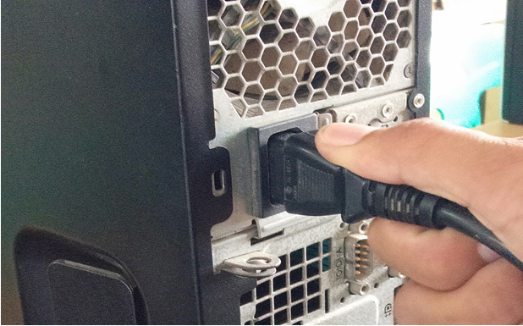
Computer Disassembly
1. Detach the Power Cable

Slide 3
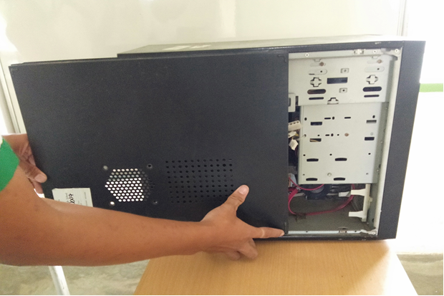
Computer Disassembly
2. Remove the Cover

Slide 4
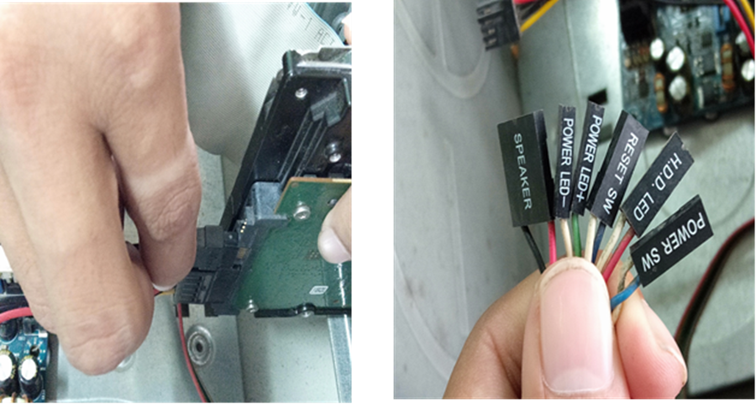
Computer Disassembly
3. Remove the Different Cables and Connectors

Slide 5
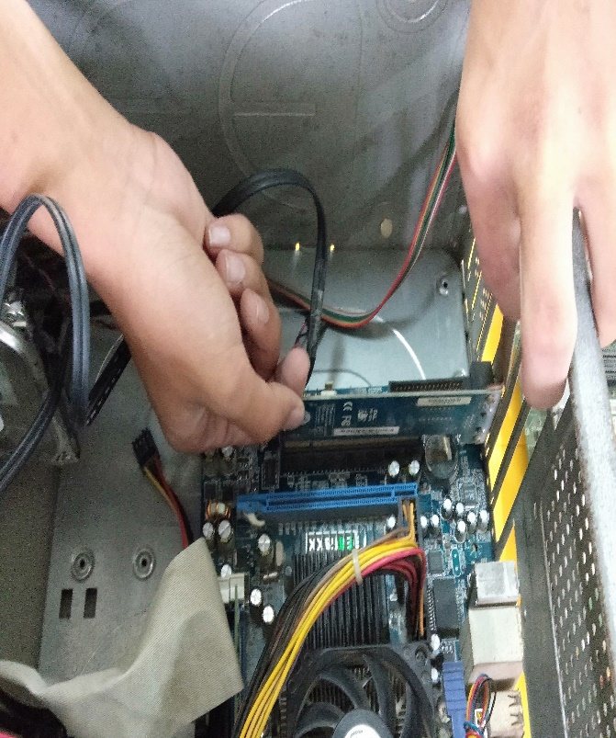
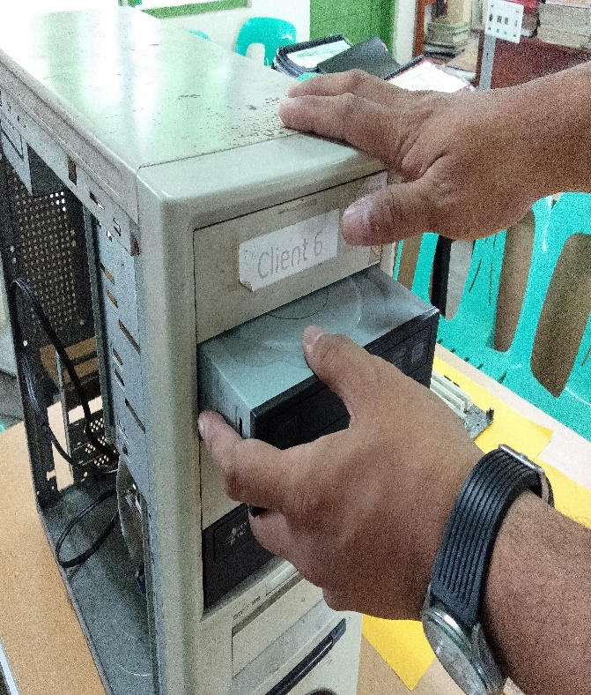
Computer Disassembly
4. Remove the Adapters and Drives

Slide 6
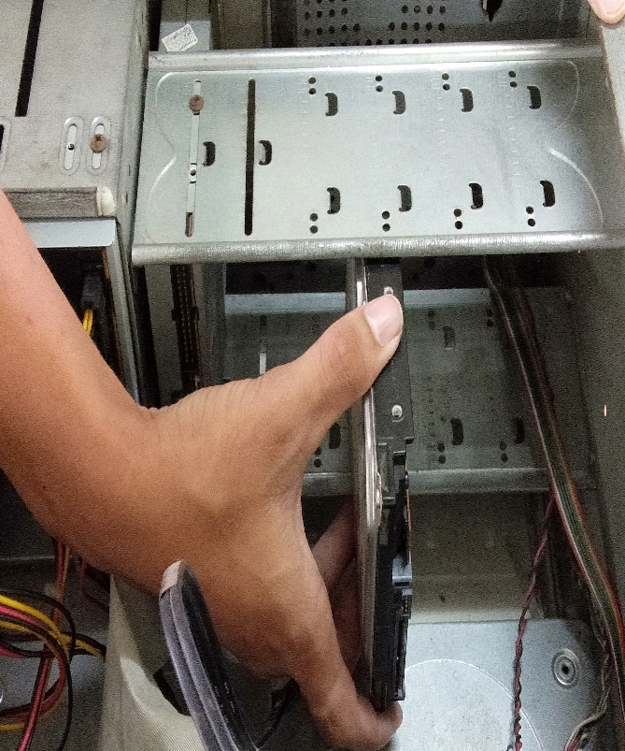
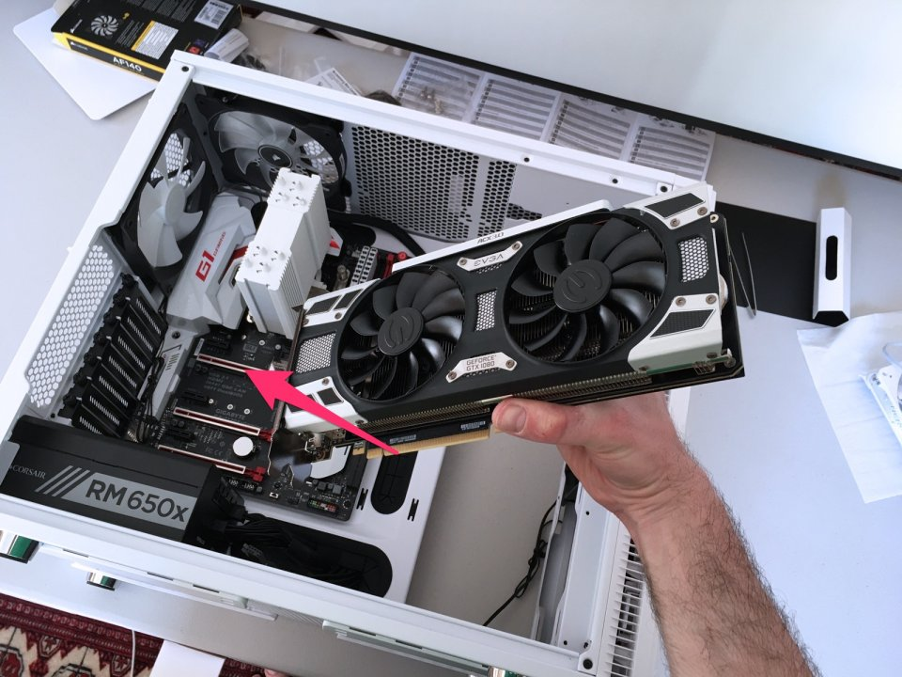
Computer Disassembly
4. Remove the Adapters and Drives

Slide 7
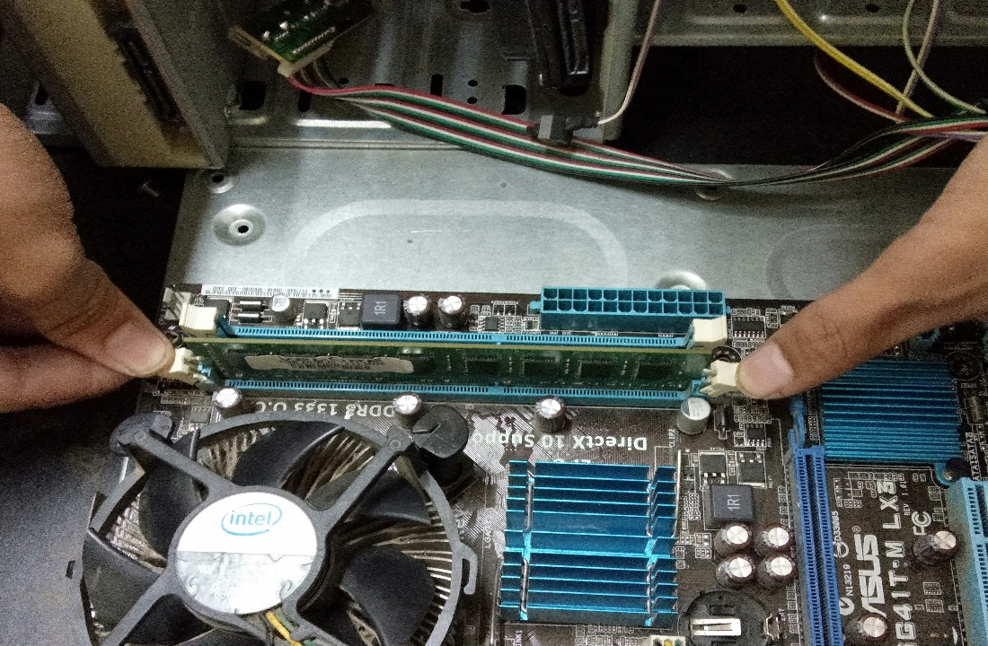
Computer Disassembly
5. Remove the Memory Module

Slide 8
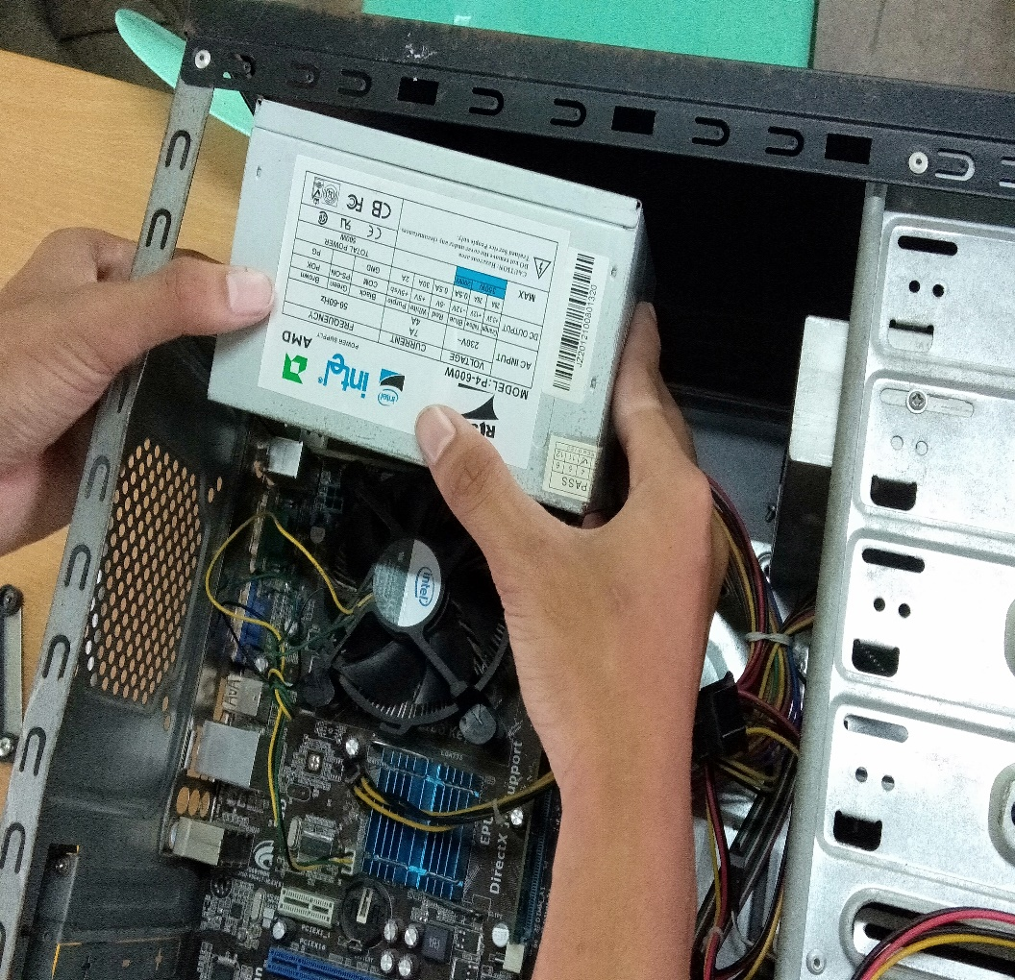
Computer Disassembly
6. Remove the Power Supply

Slide 9
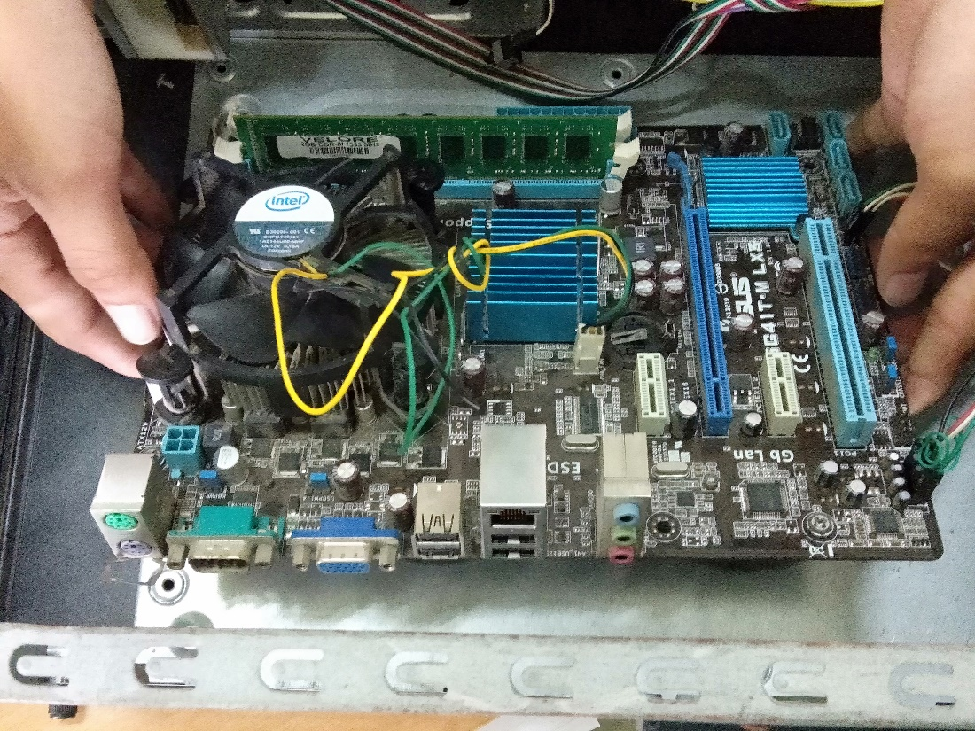
Computer Disassembly
7. Remove the Motherboard

Slide 10
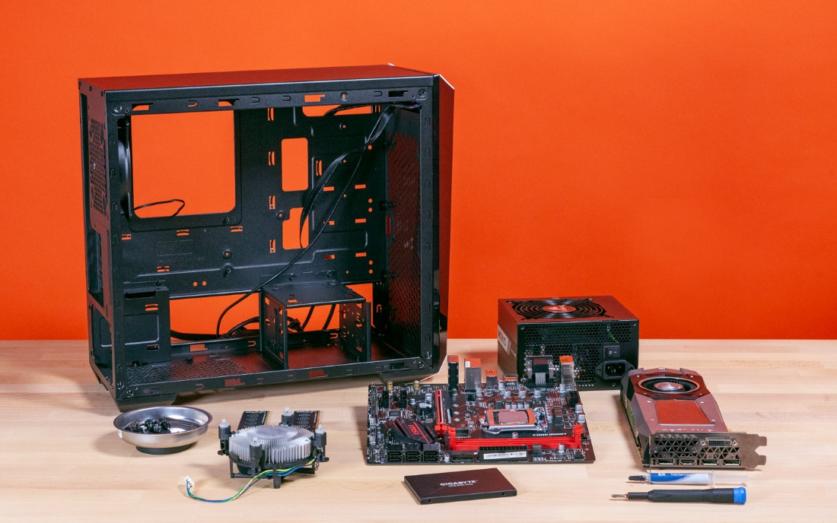
Computer Assembly
Step 1. Prepare your workplace

Slide 11
Computer Assembly
Step 1. Prepare your workplace
1. Take Inventory: Before you start, take an inventory of your parts.
2. Make Space, Make Time: Building a PC takes up space
3. Prepare Grounding Protection
4. Have the Drivers Ready

Slide 12
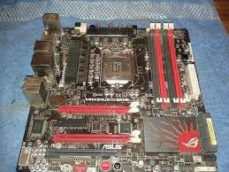
Computer Assembly
Step 2. Prepare the Motherboard

Slide 13
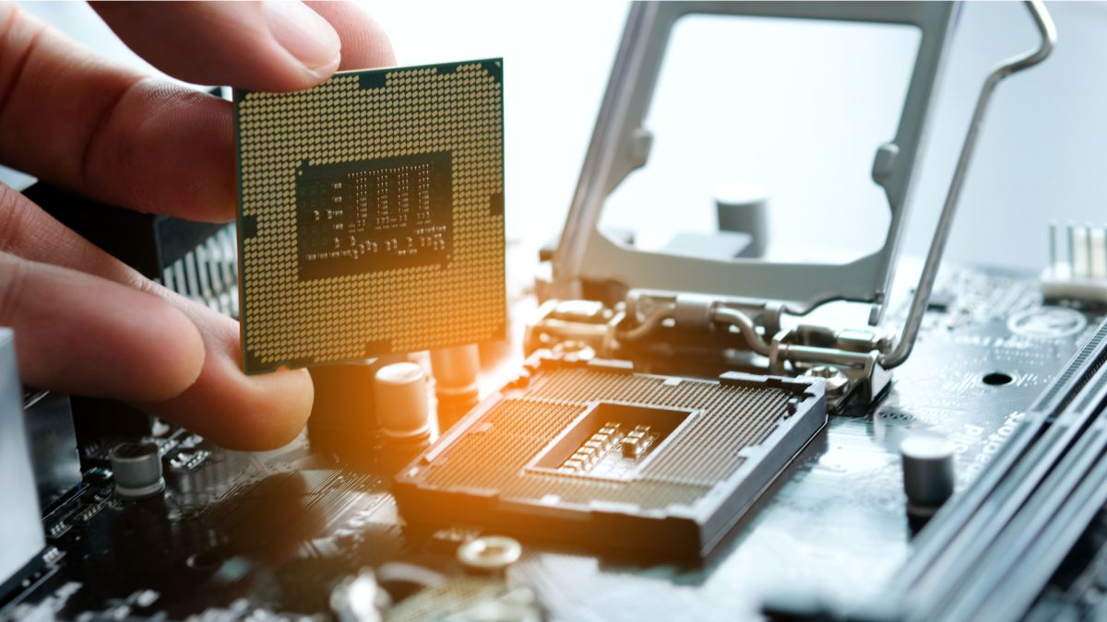
Computer Assembly
Step 3. Install the CPU

Slide 14
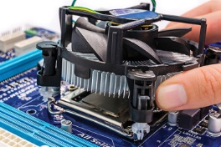
Computer Assembly
Step 4. Install the CPU Heat Sink

Slide 15
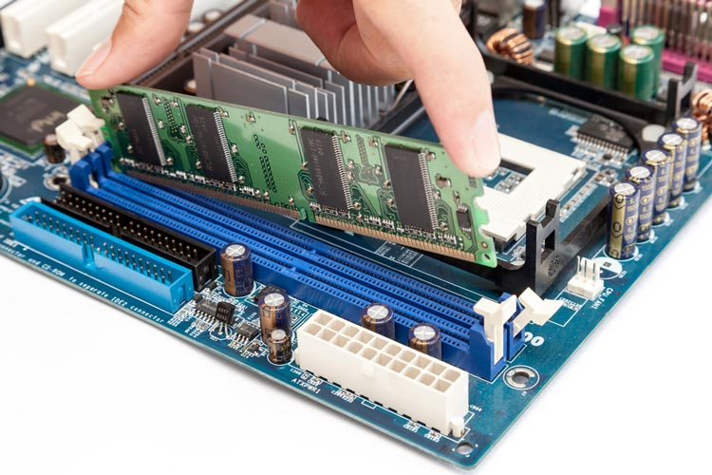
Computer Assembly
Step 5. Install Memory (RAM Modules)

Slide 16
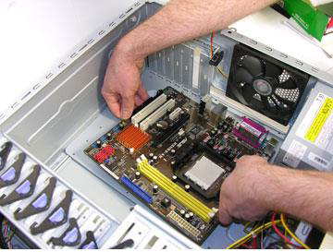
Computer Assembly
Step 6. Place the motherboard into the case

Slide 17
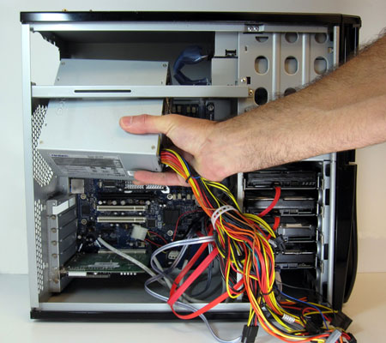
Computer Assembly
Step 7. Connect the Power Supply

Slide 18
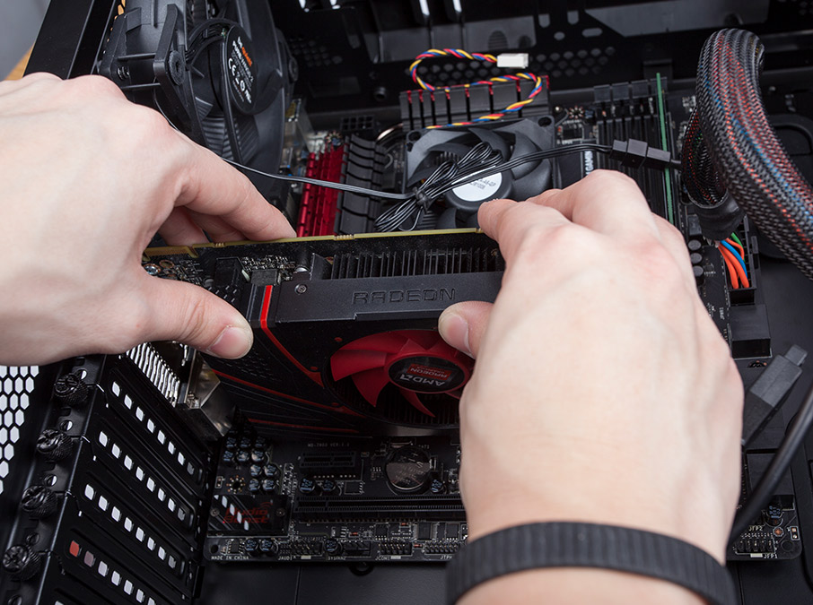
Computer Assembly
Step 8. Install Graphics / Video Cards

Slide 19
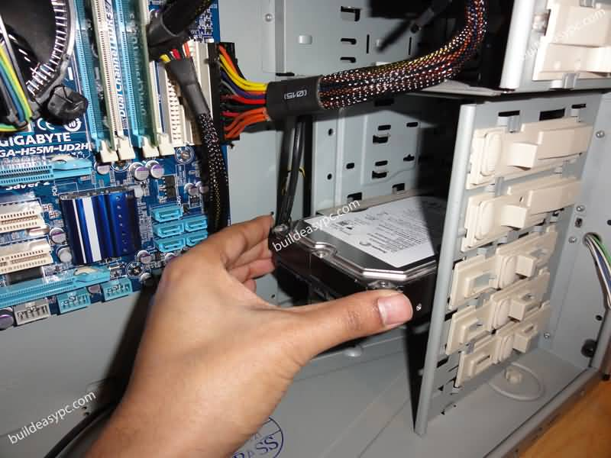
Computer Assembly
Step 9. Install Internal Drives

Slide 20
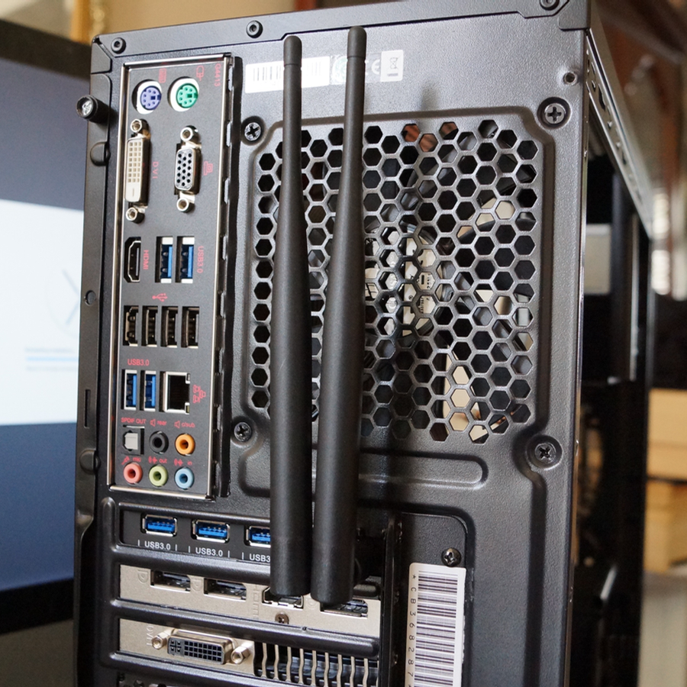
Computer Assembly
Step 10. Install the Add- in Cards

Slide 21
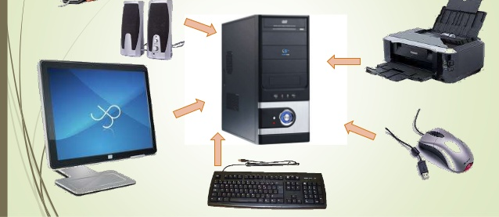
Steps in Connecting Peripherals of a PC

Slide 22
Steps in Connecting Peripherals of a PC
Step 1. Attach the monitor cable to the video port.
Step 2. Secure the cable by tightening the screws on the connector.
Step 3. Plug the keyboard cable into the PS/2 keyboard port.
Step 4. Plug the mouse cable into the PS/2 mouse port.
Step 5. Plug the USB cable into a USB port.
Step 6. Plug the network cable into the network port.
Step 7. Plug the power cable into the power supply.

